Slide 1


Securing IoT Servers Shallow vs. Deep Neural Network Architectures
Niranjan W. Meegammana Shilpa Sayura Foundation, Sri Lanka
Harinda Fernando Sri Lanka Institute of Information Technology, Sri Lanka

Slide 2
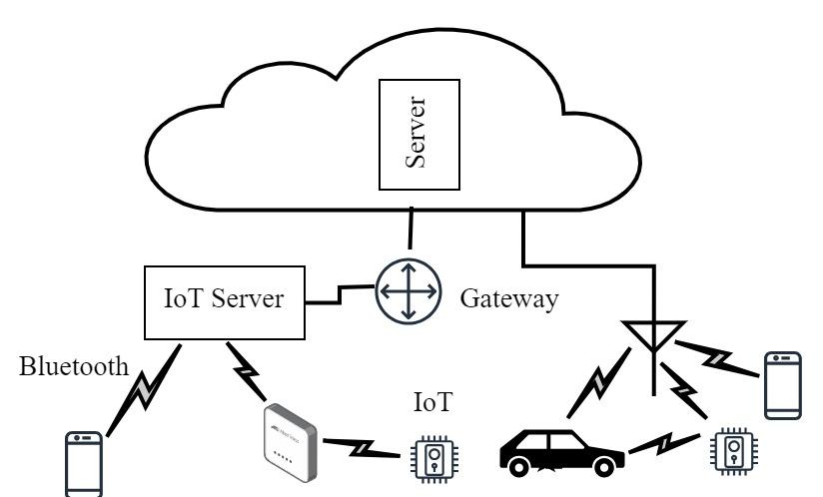
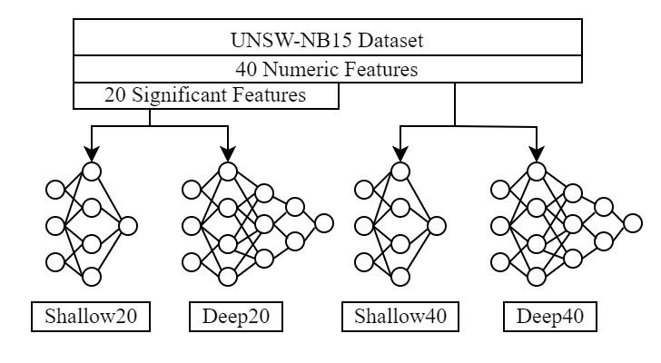
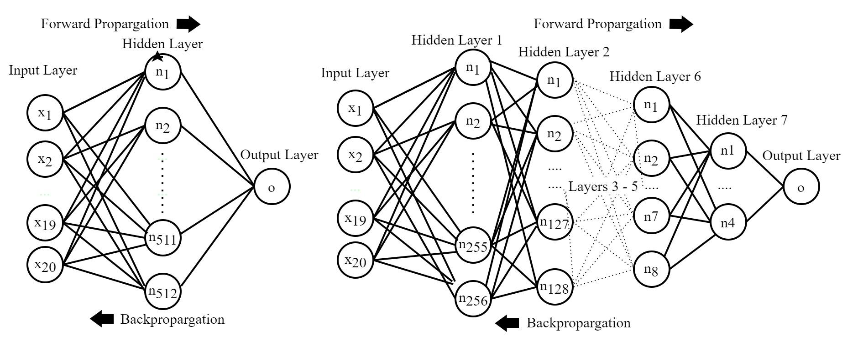
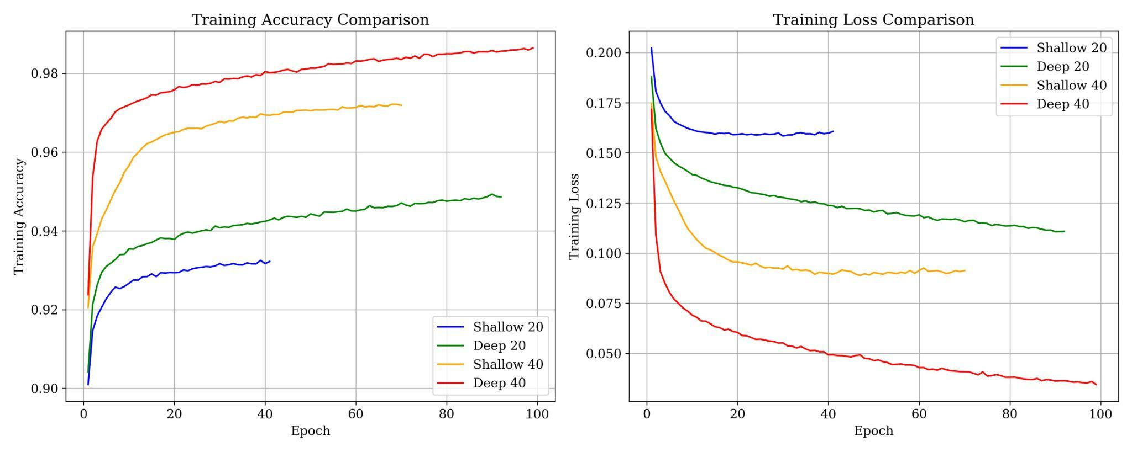
PROBLEM
METHODOLOGY
SOLUTION
IoT servers face network attacks.
IDS are not adequate.
Host based DNN can help.
Shallow and Deep NN models. Use UNSW-NB15 dataset. Train with Supervised Learning.
Deploy on IoT environments.
20 and 40 feature datasets.
Train 2 Shallow Models. Train 2 Deep Models.
Compare performance.
RESUlTS
Model Performance
Resource Usage
Deep40 Shallow20
98%
0.32%
93%
0.25%
Deep40 98% accuracy 0.32% resource usage.
Shallow20 95% of Deep40, low resource usage (75% of Deep40) suitable for resource-constrained environments.

